Slide 1
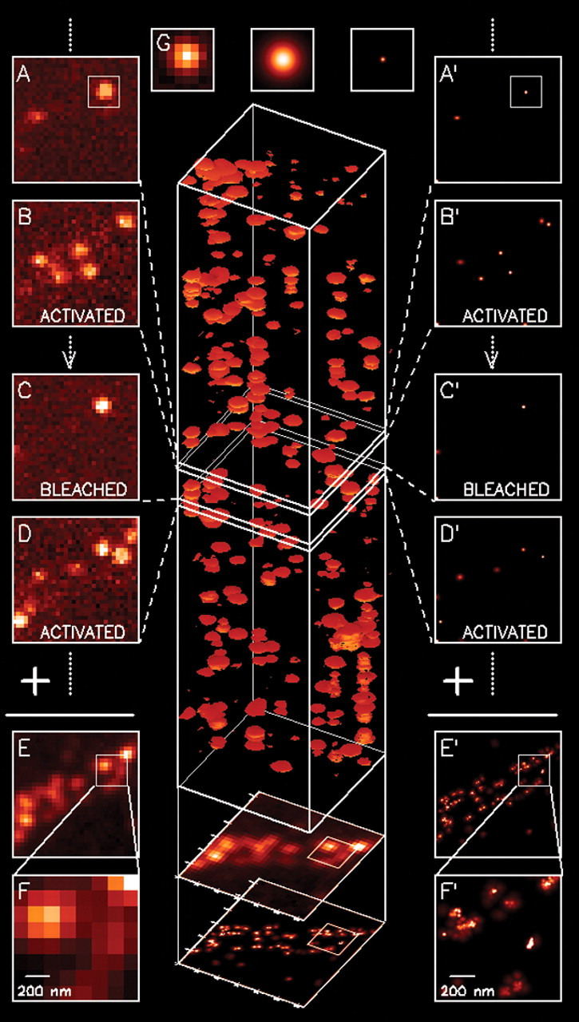
Super-resolution on Photoactivated Localization Microscopy (PALM)
Physics 305 Activity 2
2nd Sem AY 2022-2023
Mark Jeremy G. Narag
2014-64423
PhD Physics

Slide 2
Photoactivated Localization Microscopy (PALM)
Background | Methods | Results and Discussion
Super-resolution microscopy technique!
Works by activating and imaging sparse subsets of fluorophores at a time, and then repeating the process multiple times to build up a high-resolution image as shown in Fig 1 (details in the caption)
featured as Methods of the Year for 2008 by the Nature Methods journal
Fig. 1. The principle behind PALM. A sparse subset of PA-FP molecules that are attached to proteins of interest and then fixed within a cell are activated (A and B) with a brief laser pulse at λ_{act} = 405 mm and then imaged at λ_{exc} = 561 mm until most are bleached (C). This process is repeated many times (C and D) until the population of inactivated, unbleached molecules is depleted. Summing the molecular images across all frames results in a diffraction-limited image (E and F). However, if the location of each molecule is first determined by fitting the expected molecular image given by the PSF of the microscope [(G), center] to the actual molecular image [(G), left], the molecule can be plotted [(G), right] as a Gaussian that has a standard deviation equal to the uncertainty σ_{x,y} in the fitted position. Repeating with all molecules across all frames (A′ through D′) and summing the results yields a superresolution image (E′ and F′) in which resolution is dictated by the uncertainties σ_{x,y} as well as by the density of localized molecules. Scale: 1 × 1 μm in (F) and (F′), 4 × 4 μm elsewhere. [1]
[1] Betzig, E., Patterson, G. H., Sougrat, R., Lindwasser, O. W., Olenych, S., Bonifacino, J. S., ... & Hess, H. F. (2006). Imaging intracellular fluorescent proteins at nanometer resolution. science, 313(5793), 1642-1645.

Slide 3
Photoactivated Localization Microscopy (PALM)
Background | Methods | Results and Discussion
This technique has both optics and image processing side [2]:
Optics side:
Photoactivatable fluorescent dyes
Widefield fluorescent microscope – a Total Internal Reflection Microscope
A means to switch on and off an activation and readout laser
A highly sensitive CCD camera
Image processing side:
Stacking of images
Gaussian fitting
In this activity, we will do gaussian fitting on the stacked images to super-resolve it!
[2] Soriano, M. 2023. Photoactivated Localization Microscopy (PALM). Physics 305 Computational Imaging Manual

Slide 4
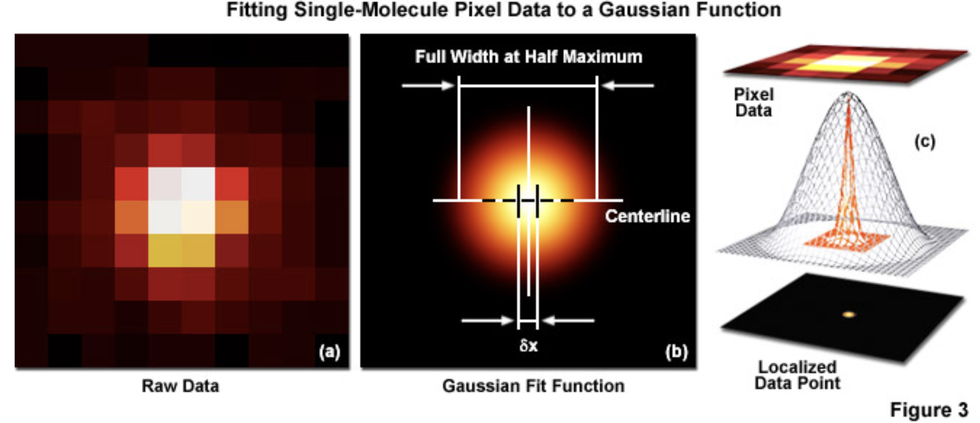
Background | Methods | Results and Discussion
Super-resolve it? Gaussian fitting? But why?
However, even when there is no confounding background, a molecule imaged with N detected photons will appear noisy and spread with a width approaching the diffraction limit. In order to localize the centroid of the diffraction-limited spot, the image is typically analyzed by applying a least-squares fit to a Gaussian approximation of the point-spread function (or the function itself if that can be determined). Presented in Figure 3 are simplified illustrations of the single-molecule localization process. The image of a single emitter (considered raw data; Figure 3(a)) is mathematically treated to fit a two-dimensional Gaussian function and localized with nanometer accuracy (Figure 3(b)). The entire process is schematically depicted in Figure 3(c) to show the Gaussian profile of a point-spread function sandwiched between the raw and processed data [3].
[3] ZEISS Microscopy Online Campus | Practical Aspects of Photoactivated Localization Microscopy (PALM) (fsu.edu)

